Slide 1

Analogue signal and image processing with large memristor crossbars Can Li , Miao Hu, Yunning Li, Hao Jiang, Ning Ge, Eric Montgomery, Jiaming Zhang2

Slide 2
define
Memristor crossbars offer reconfigurable non-volatile resistance states and could remove the speed and energy efficiency bottleneck in vector-matrix multiplication, a core computing task in signal and image processing.
Improvements in the energy consumption and throughput of digital processors are reaching a plateau, as complementary metal-oxide- semiconductor transistor (CMOS) technology approaches the end of process scaling.
Many of these operations can be expressed as a vector-matrix multiplication (VMM), which in principle can be performed in the analogue domain by a memristor crossbar array using Ohm’s law for multiplication and Kirchhoff ’s current law for summation.
128 × 64 memristor crossbars , To precisely tune the conductance of each memristor in a crossbar, we monolithically integrated a memristor on top of a metal–oxide–semiconductor (MOS) transistor as an access device in each cell, which is known as the ‘1T1R’ architecture.

Slide 3
128 × 64 1t1R memristor crossbar
Data stored in a 128 × 64 1t1R memristor crossbar.
a, Schematic of the VMM operation.
b, A 2 cm × 2 cm detail from a photograph showing two dies of 1T1R memristor crossbars.
c, Microscope image of four cells in a 1T1R array (scale bar, 10 μm).
d, Photograph of a probe card in contact with an operational 128 × 64 1T1R array (scale bar, 500 μm).
e, Quasi-d.c.
f, Histogram of the initial difference between the target and measured conductance written into a 128 × 64 array.
g, Room-temperature state retention and read disturb of the device states.
h, Histogram of the normalized standard deviation (s.d.)

Slide 4
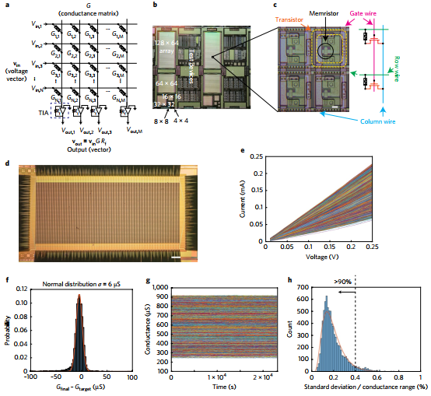
128 × 64 1t1R memristor crossbar

Slide 5
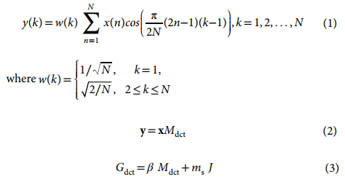
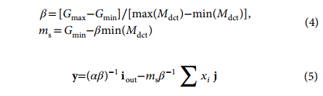
Analogue signal processing
We first configured the array to implement the discrete cosine transformation (DCT) as a typical example of a linear transformation.

Slide 6
Analogue signal processing Count.
After configuring one 64×64 crossbar with the forementioned first approach, the linear transform to map DCTmatrix values to memristor crossbar conductance, we quantitatively analysed the output accuracy of the memristor DCTs by plotting the experimental measurements versus the expected currents for each column for a range of inputs.
Typical histogram of the estimated output error for a 64×64 memristor crossbar from all the columns, with input vectors representing image pixel intensities multiplied by a fixed DCT matrix .

Slide 7
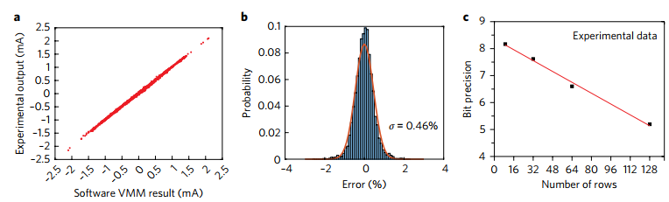
Experimental
Experimental output accuracy and precision for discrete cosine transformation (DCt) using memristor crossbars.
a, Relation between experimental output and the software DCT result, agreement and thus high accuracy.
b, Histogram of the DCT estimated output error for the 64 × 64 crossbar,
c, Bit precision estimated from standard deviations of the output error for crossbars of different sizes.

Slide 8
Experimental Count.
The experimental crossbar output displays the frequency spectrum, showing good agreement with the software DCT in MATLAB .
(a) Input voltage signals (sine waves) with different frequencies.
(b) and MATLAB calculated output
(c) from the array, showing good agreement. Frequencies are represented by column numbers in this demonstration.

Slide 9
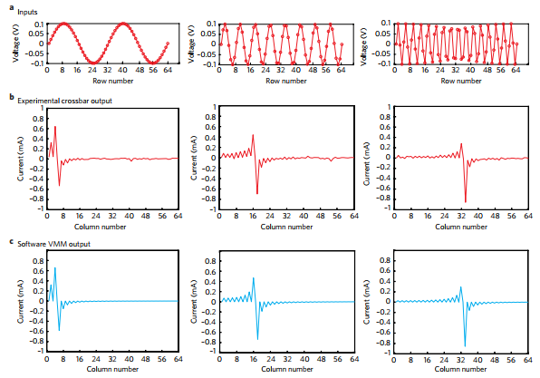
Experimental Count.

Slide 10
Algorithm Count.
Images with pixel counts larger than the crossbar were divided into sub-images, processed in series, and then tiled together after reconstruction.
In this case we used differential pairs of memristors in neighbouring rows to represent DCT matrix elements, and thus the 64×64 DCT matrix was experimentally represented by the full 128×64 memristor crossbar .
The results are compared with those using the MATLAB 2D DCT to compress the image in Fig.c,d.

Slide 11
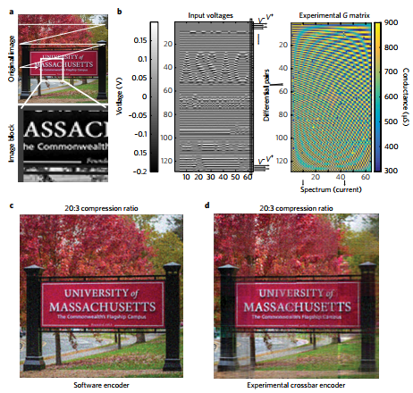
Experimental 2D DCt

Slide 12
Convolutional image filtering
We also experimentally demonstrated 2D convolution for image filtering.
We used 10 different convolutional filters: Gaussian, disk and average to smooth out noisy images, Laplacian of Gaussian (LoG) with three different parameters, Sobel (both x and y gradient) to extract the edges and Motion (two directions) to mimic the motion blur effect.
We added artificial Gaussian white noise to the original 128×128 Lena image to show how the convolutions damp out noise and are able to locate edges.
The noisy Lena image was used as input, the image intensity of which was converted into voltages applied to the rows of the crossbar .

Slide 13
Convolutional image filtering
a, The input image was a standard Lena image with artificially added Gaussian white noise. Each colour channel of the image is represented by a floating-point number between 0 and 1, and the added noise has a standard deviation of 0.004 and zero mean.
b, Measured conductance after programming 10 convolutional filters into the 25 × 20 crossbar. The pixel intensities, represented by two voltages with equal amplitude and opposite polarity, were input into the crossbar onto a pair of memristors in adjacent columns. The difference in the conductance of the memristor pair represents one matrix element of a convolution.
c, Ten different filtered images obtained in parallel by the convolution operation: Gaussian, disk and average reduce noise by smoothing the image, Laplacian of Gaussian (LoG) with various parameters and Sobel (x and y gradient) were used to detect edges, and Motion to generate motion blur.

Slide 14
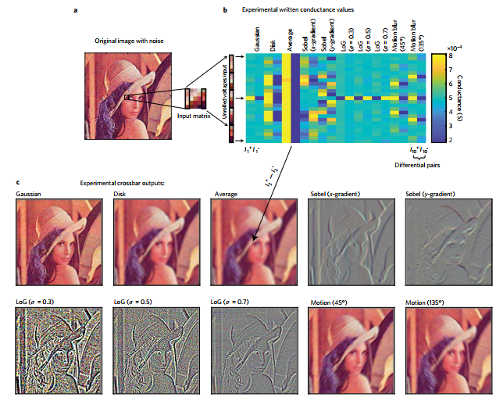
Convolutional image filtering

Slide 15
Conclusions
We have demonstrated analogue-vector and analogue-matrix-vector multiplication using crossbars with over 8,000 memristors, with an equivalent 6-bit or 64-level precision and 99.8% device yield.
The device conductance states were precisely tuned and the I–V characteristics were linear, ideal for analogue computing.
We have successfully implemented some important applications for IoT and edge computing, including signal processing, image compression and convolutional filtering.
The energy efficiency of the system was over 119.7 trillion quivalent operations per second per watt using a readout of 10 ns, and this is expected to increase significantly with larger vectors and matrices and with improvements in circuitry.
Our results are an encouraging advance in the hardware implementation of computing using emerging devices, and provide a promising path towards energy-efficient analogue computing based on memristors.

Slide 16
Thank you for your attention

